Slide 5
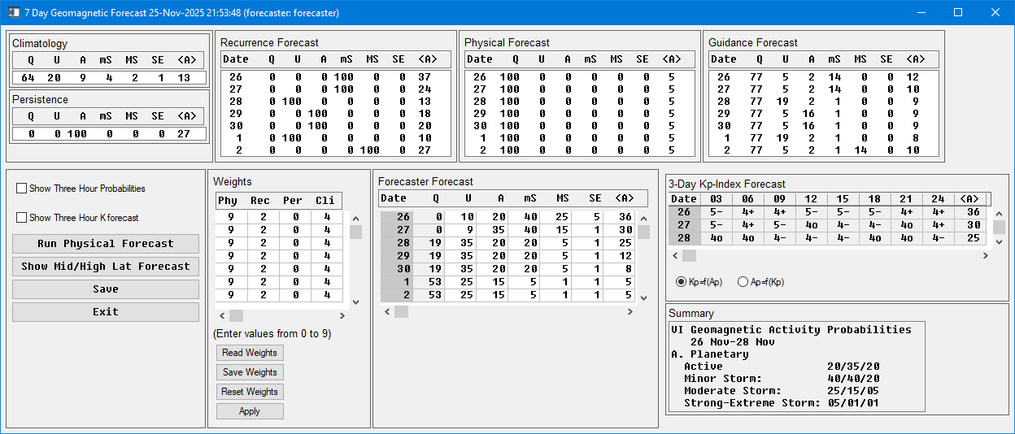
Forecasting Kp/Ap
Climatological forecast: is the average conditions over time (benchmark).
Persistence forecast: tomorrow’s condition will mimic today’s.
Recurrence forecast: max Kp level observed 27 days ago (Approx. 1 full Solar rotation).
SWPC forecasts three days of Kp values and seven days of Ap values. A 3-day forecast goes out twice a day at 0030z and 1230z.
Longer predictions are included in the 27-day Outlook product that gets issued once a week on Sunday night (MST).

Slide 7
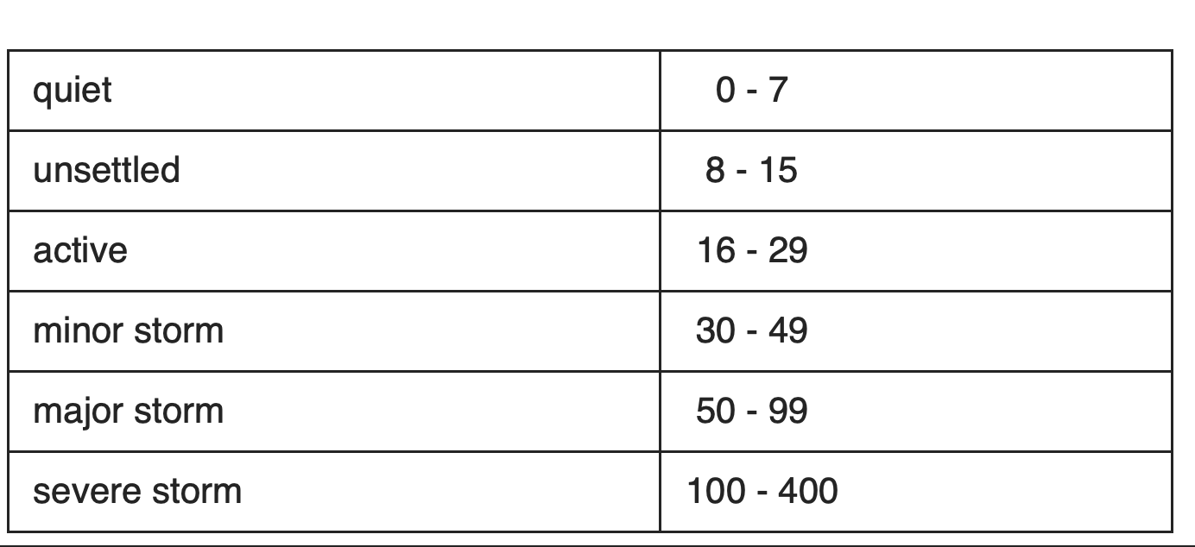
https://www.swpc.noaa.gov/content/space-weather-glossary#:~:text=hydrogen.-,geomagnetic%20activity
a-index
Activity Level Probabilities
Q – Quiet
U – Unsettled
A – Active
mS – Minor Storm
MS – Major Storm
SE - Severe-Extreme Storm

Slide 8
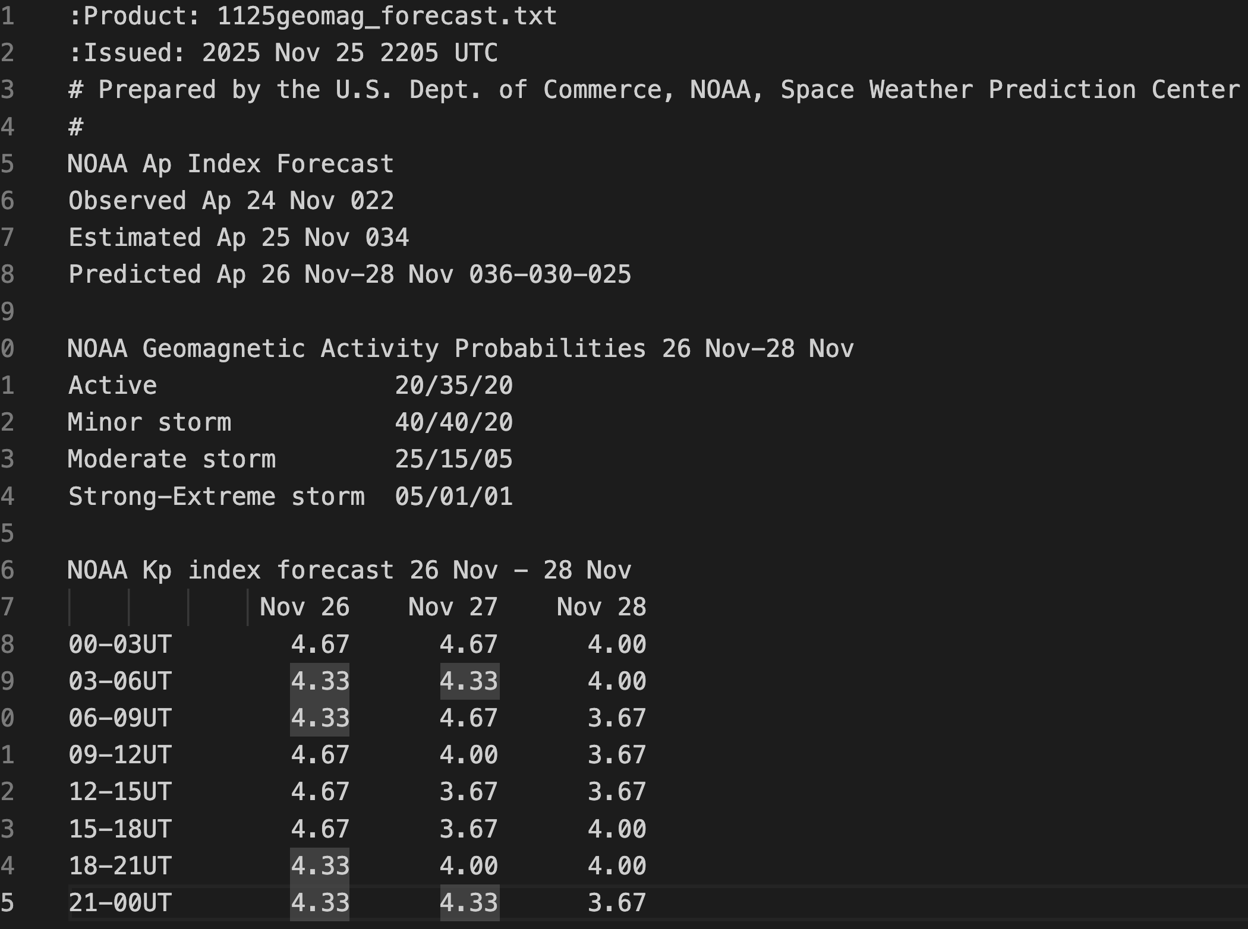
Other reports likely use the same or a similar process for generating forecasts

